Slide 1
Chapter 5
Pressure
Dr rafid albadr |

Slide 2



Ch_5: Pressure:
Blood pressure is commonly reported in mmHg, as in 120/80, which means that the systolic and diastolic pressures are, respectively, 120 mmHg and 80 mmHg. Air pressures in the body, such as in the lungs, are sometimes expressed in terms of cm or inches of water, because it is a smaller and much more convenient unit

Slide 3
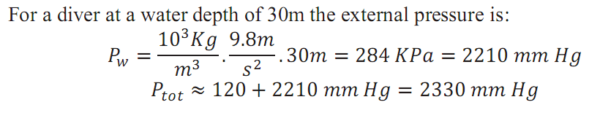
Typical blood pressure for healthy adult rang between 100-120Hgmm
(13.3-15.8 kPa). The typical air pressure on the entire body is
1 atm = 760 mm Hg
the total blood pressure is therefor:

Slide 4

Measuring of Pressure in the body
When both sides of the manometer are open to the atmosphere, the mercury levels are the same.
The measured pressure is that corresponding to the height of the fluid
$$P= P_{ref}+ ρ g h$$
the difference in mercury levels h is a measure of the pressure difference-commonly reported in millimeters of mercury (mmHg).

Slide 5
Measuring of Pressure in the body
The most common way to measure blood pressure is with a sphygmomanometer

Slide 6
SURFACE TENSION
The surface tension (symbol γ, the Greek letter gamma) of a liquid is the force per unit length with which the surface pulls on its edge.
The Law of Laplace is also important in spheres, such the alveoli in the lungs. For a sphere of radius R and wall thickness w, we can balance the forces in the half sphere. The total downward force is the area of the walls, 2πRw, times the stress, σ, or 2πRwσ. The total upward force is the cross-sectional area, πR2, times the pressure difference, ΔP, or πR2(ΔP). In equilibrium

Slide 7
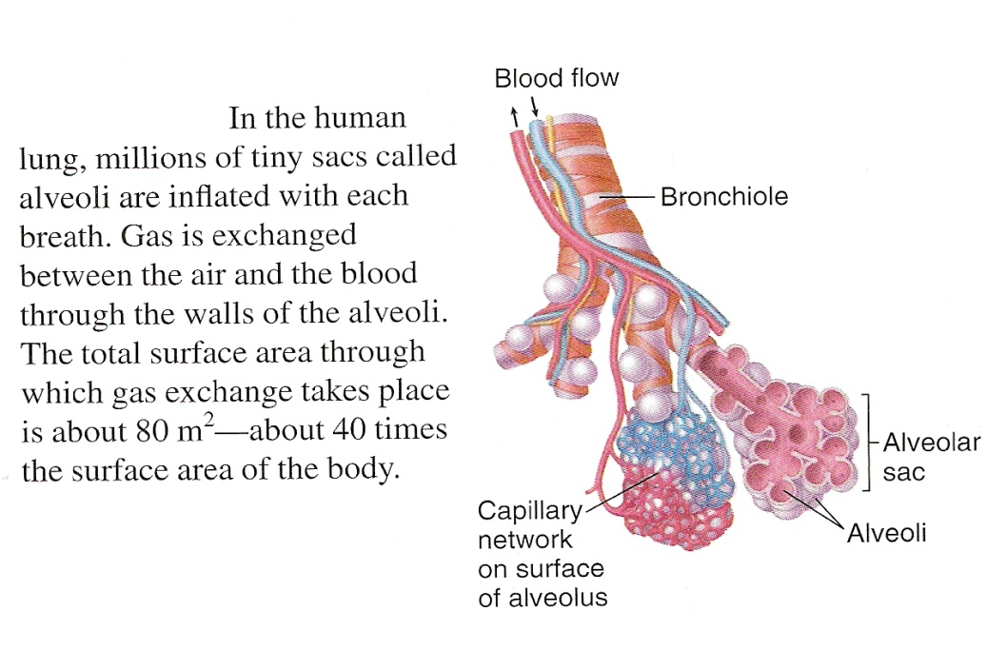

$πR^{2}∆P=2πRσw$
$∆P=\frac{2wσ}{R}=\frac{2T}{R}$
The pressure inside a bubble is inversely proportional to the radius and directly proportional to the surface tension γ.
$$∆P=P_{in}−P_{out}=\frac{2T}{R}=\frac{4γ}{R}$$

